Slide 1
Logistic Regression

Slide 2
Logistic Regression
Logistic Regression is used for classification problems.
It provide probability of certain event.
Logistic function is used in logistic and produces an output between 0 & 1. It uses the concept of threshold value to convert values to 0 or 1.
Logistic regression works with both-continuous & discrete data.
Logistic regression produces categorical output like yes/no, true/false.
Also known as logit model.

Slide 3
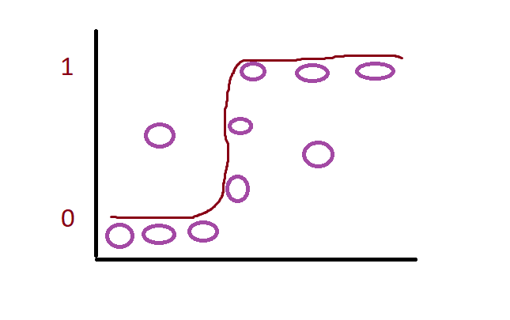
S Shaped Curve

Slide 4
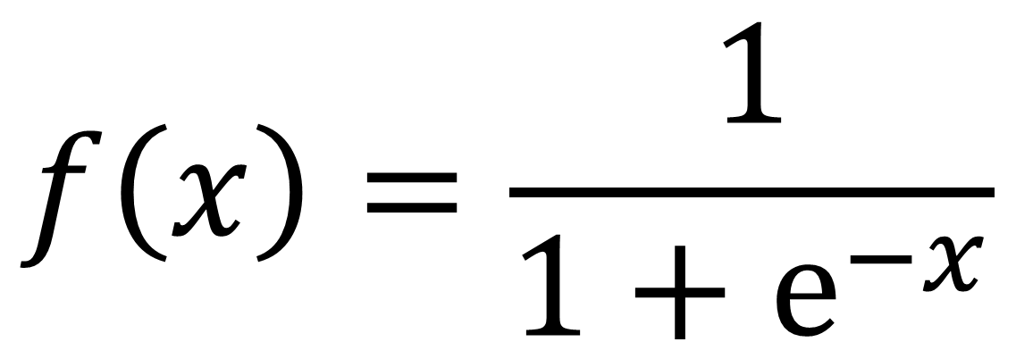
Logistic Regression
$$f\left(x\right)=\frac{1}{1+ⅇ^{−x}}$$

Slide 5
Logistic Regression
Logistic Regression is a type of GLM(generalized linear model).
We can use logistic regression for more complex problems because it is non-linear.
Logistic regression doesn’t have residuals, least squares and doesn’t use R2.
Logistic use “maximum likelihood”.

Slide 6
Linear vs Logistic
Linear Regression | Logistic Regression
Straight line | S curved
Used for finding continuous values | Used for finding binary output

Slide 7
Logistic Regression Summary
Summary report will contain following important elements;
Estimates- they represent beta values like beta0, beta 1 etc.
P value with * (stars)
*** mean 99.9% confident
** mean 99% confident
* 95% confident
. Mean 90% confident
Null deviance is the deviance if you were to only use Beta0 and not other variables.
Residual deviance is the deviance which you get when you include independent variables like beta0, beta 1 etc. It represent the deviance of the model.
AIC- lower the better. It is used for model evaluation.
When you change variables in model, residual deviance shouldn’t increase & AIC should go down.

Slide 8
Prediction & Classification
Predictvalues<- Predict(trainmodel, testsample, type=“response”)
Table(ActualValue=testing$type, Predictedvalue=res>0.5)
Library(ROCR)
ROCRcalculation <- prediction(predictvalues,training$type)
Rocrpref <- performance(ROCRcalculation, “tpr”,”fpr”) tpr=true positive, fpr-false positive rate.
Plot(Rocrpref)

